Slide 1

Bachelor Of Science In Mathematics
DEPARTMENT OF MATHEMATICS
GOVERNMENT ARTS AND SCIENCE COLLEGE
THENNANGUR-60408
OCTOBER 2023

Slide 2

Irevolution : A Data-Driven Exploration Of Apple’s Iphone Impact In India
TEAM LEADER :
S.LAVANYA
TEAM MEMBERS :
E.KRISHNAMOORTHI
S.SANTHOSH KUMAR
M.GOMATHI
OUR MENTOR :
MR.R.SUDHAGAR
DEPARTMENT OF MATHEMATICS

Slide 3

IRevolution: A Data-Driven Exploration Of Apple’s Iphone Impact In India

Slide 4

INTRODUCTION :
The iphone is a smartphone made by Apple that combines a computer, iPod, digital camera and cellular phone into one device with a touchscreen interface.
The iPhone runs the IOS operating system, and in 2021 when the iPhone 13 was introduced, it offered up to 1 TB of storage and as 12- megapixel camera

Slide 5
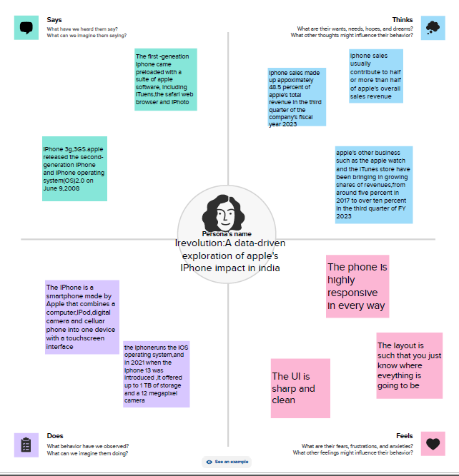

Slide 6
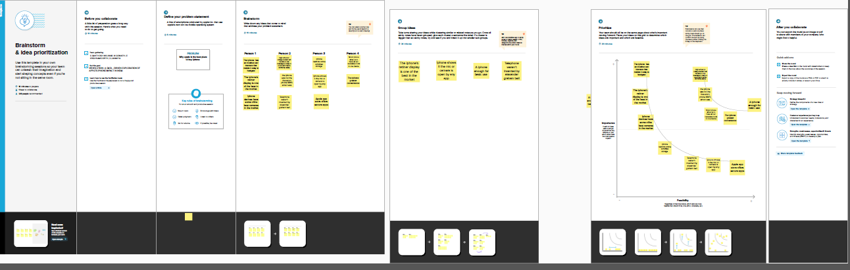

Slide 7
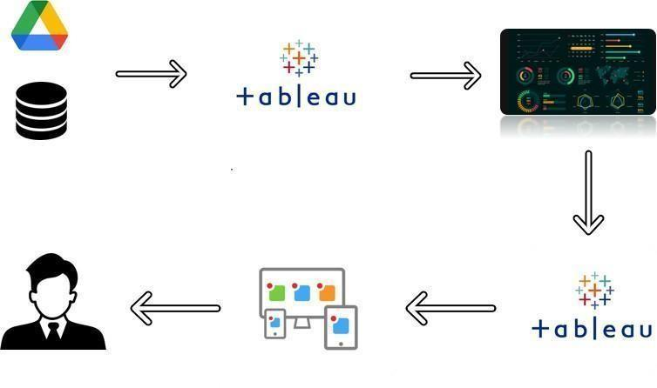

Slide 8

Visualisations

Slide 9
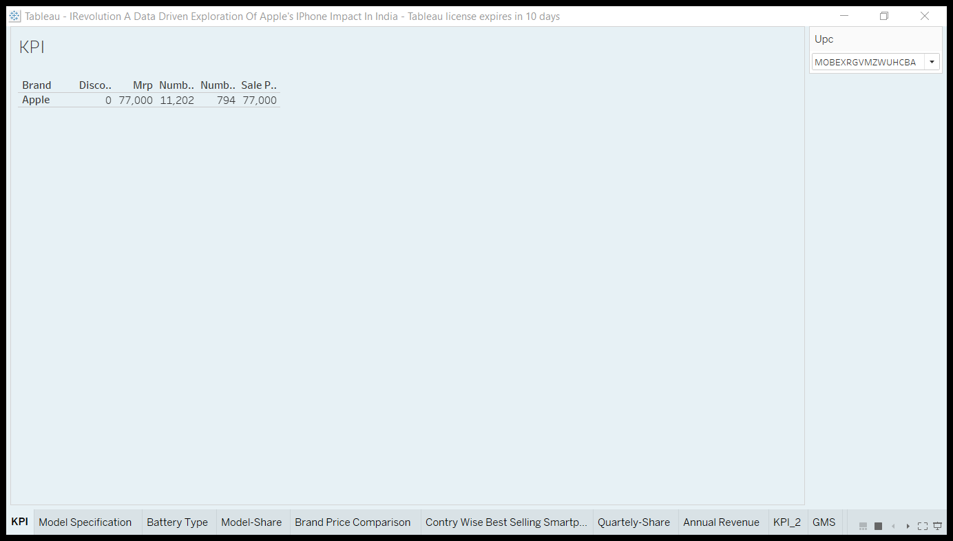

Slide 10
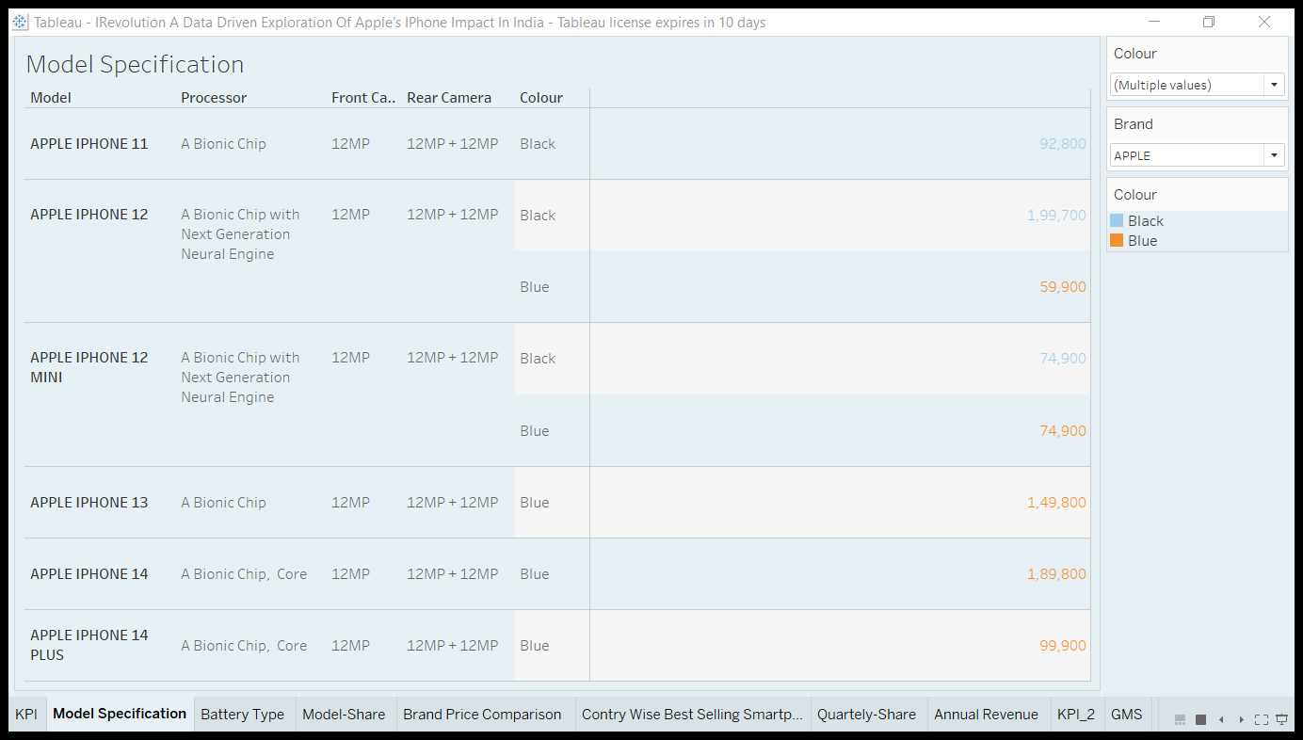

Slide 11
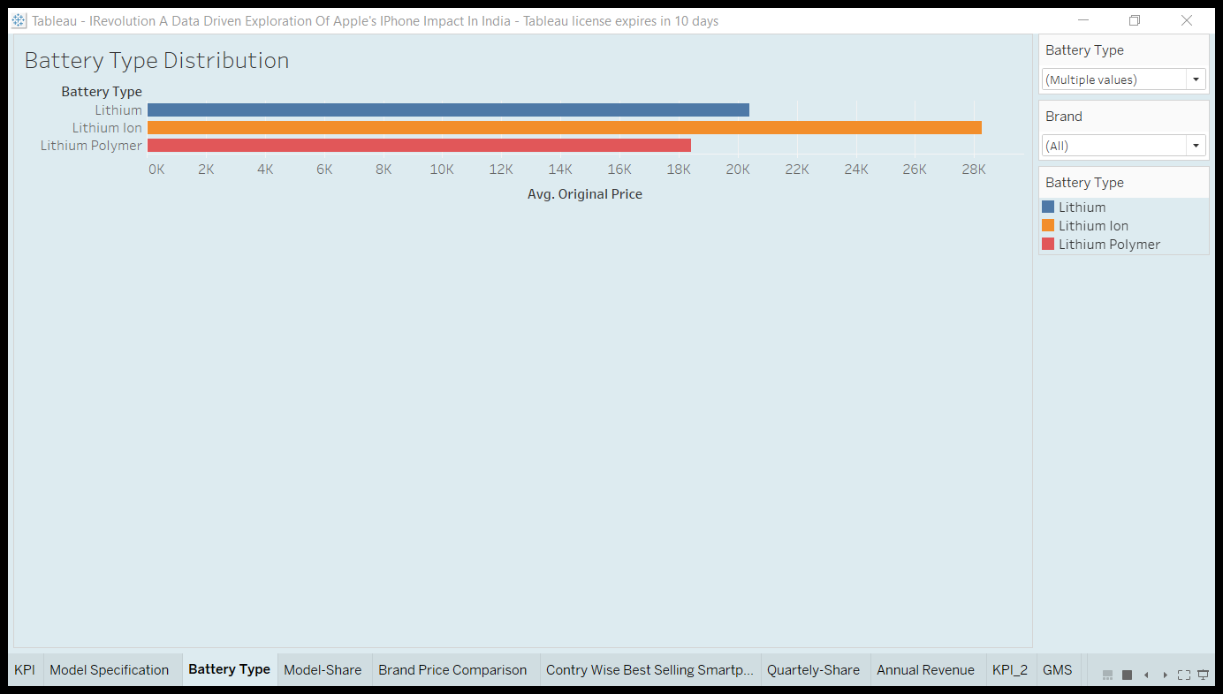

Slide 12
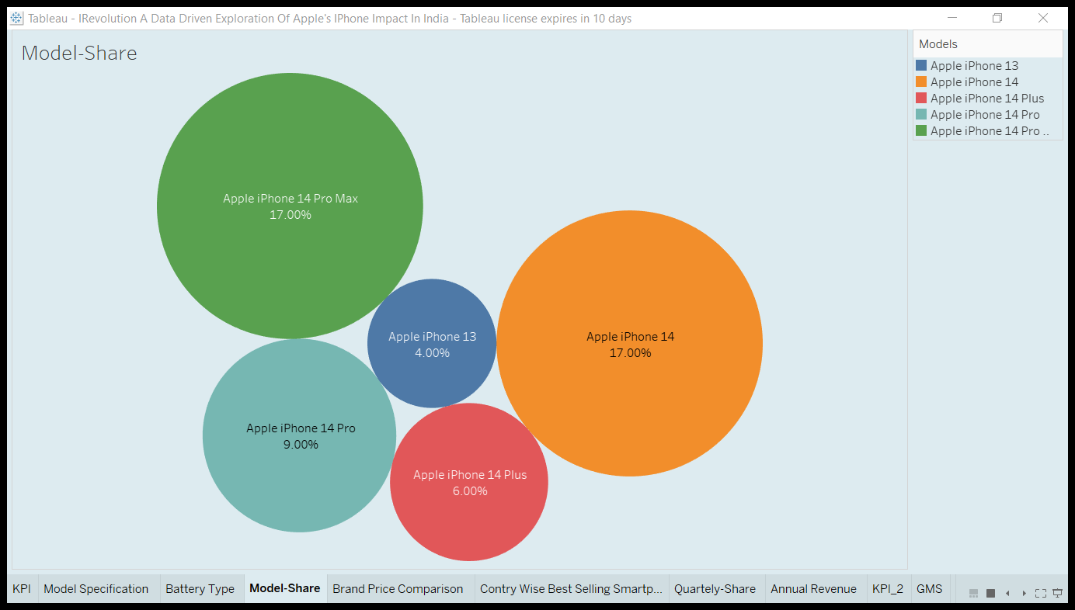

Slide 13
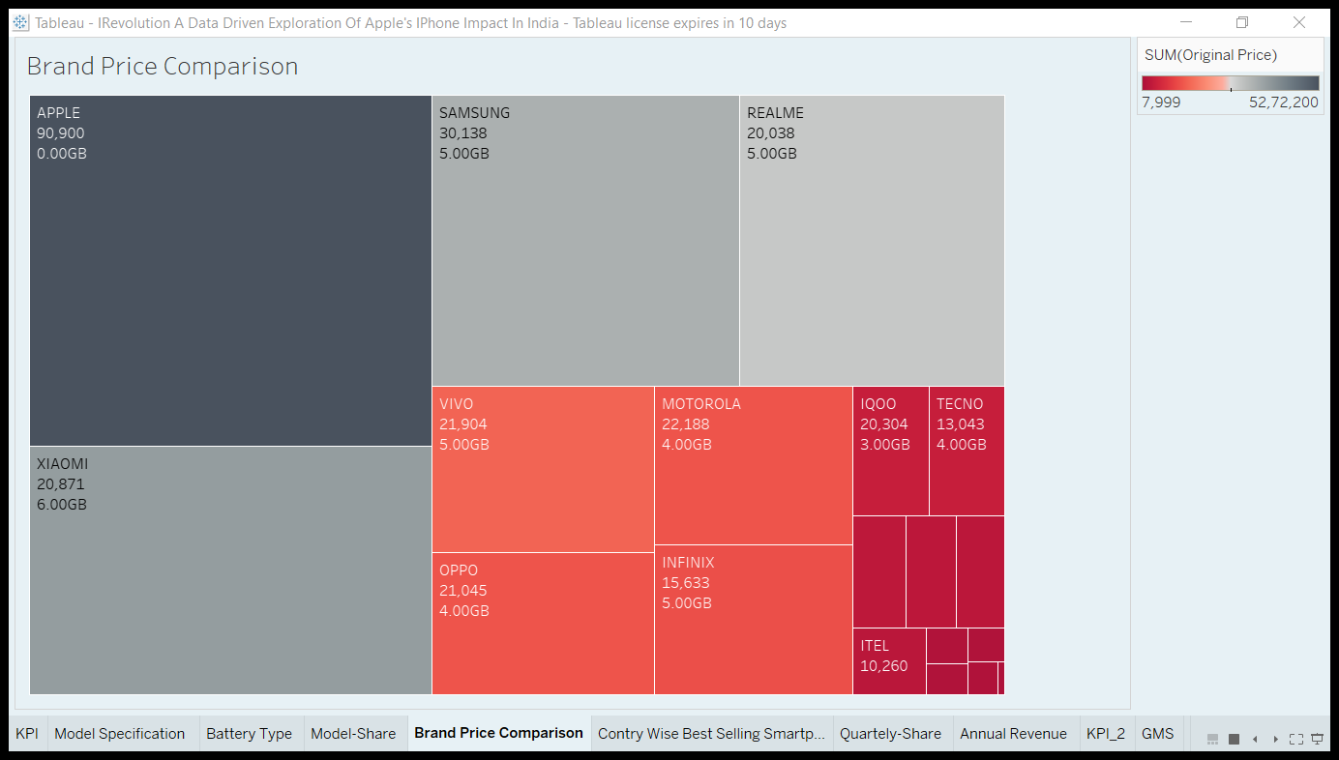

Slide 14
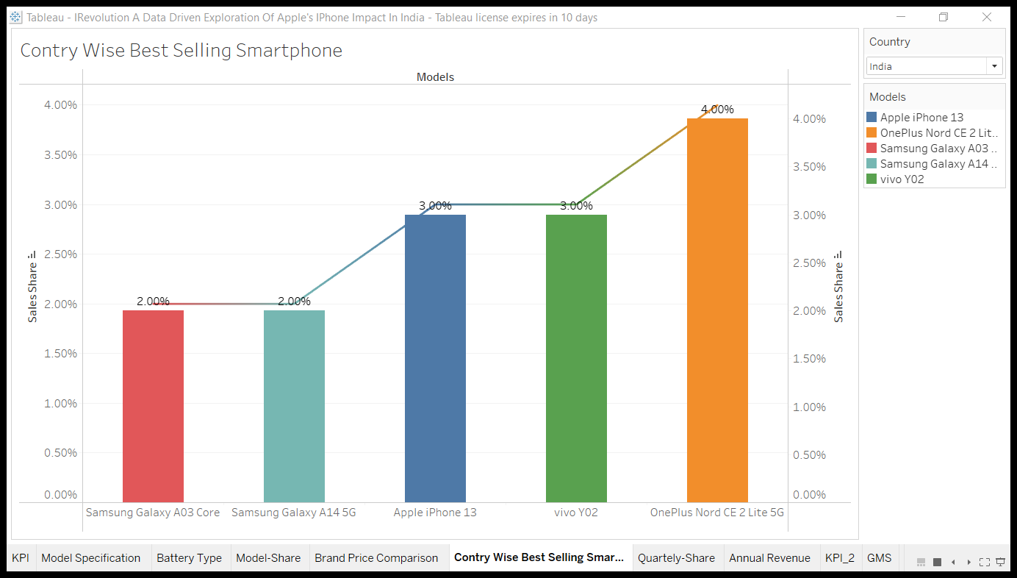

Slide 15
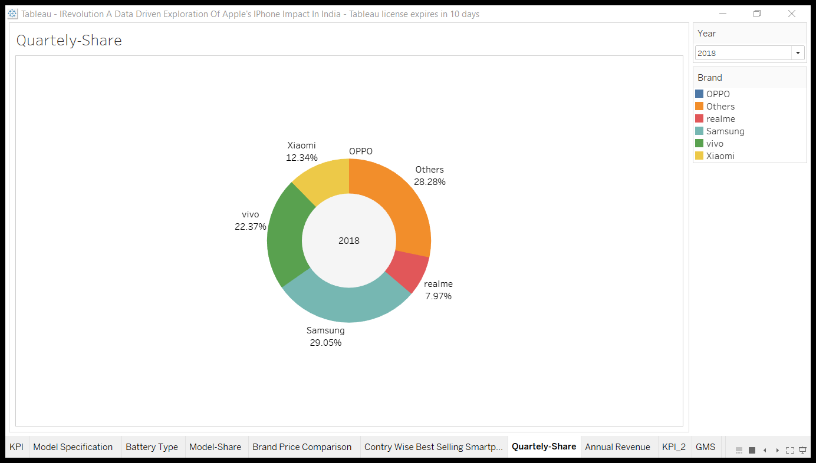

Slide 16
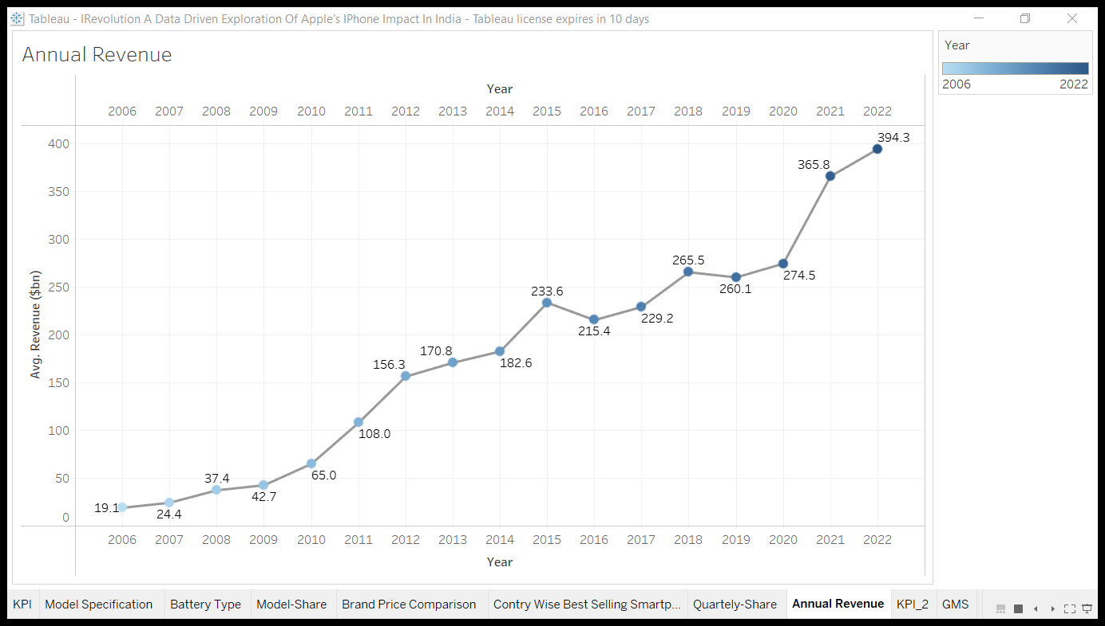

Slide 17
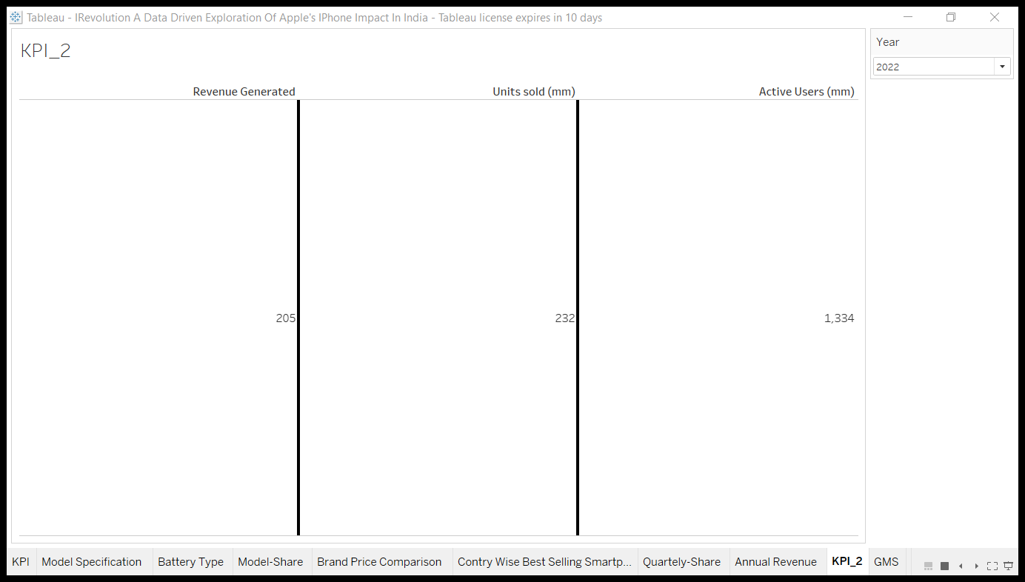

Slide 18
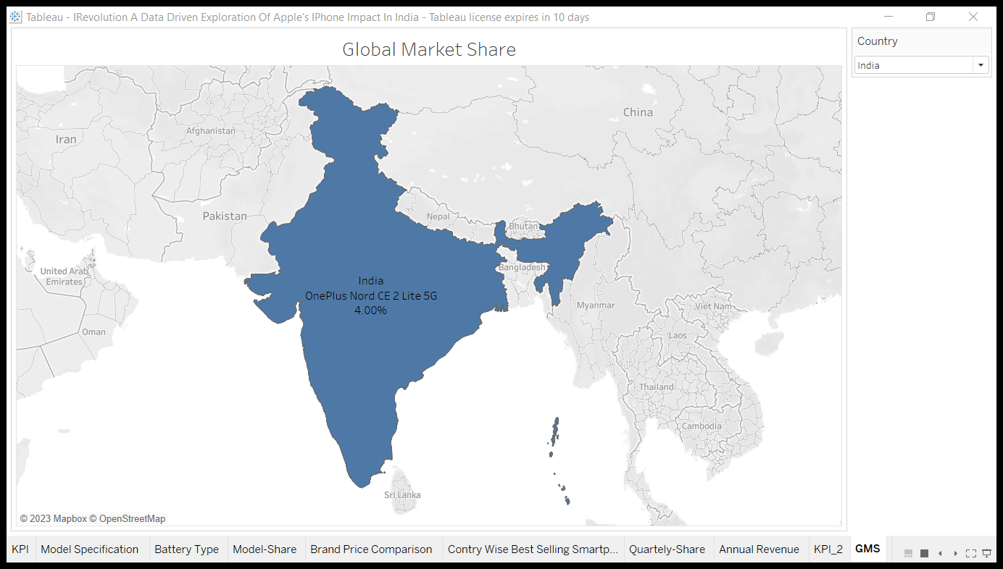

Slide 19

Dashboards

Slide 20
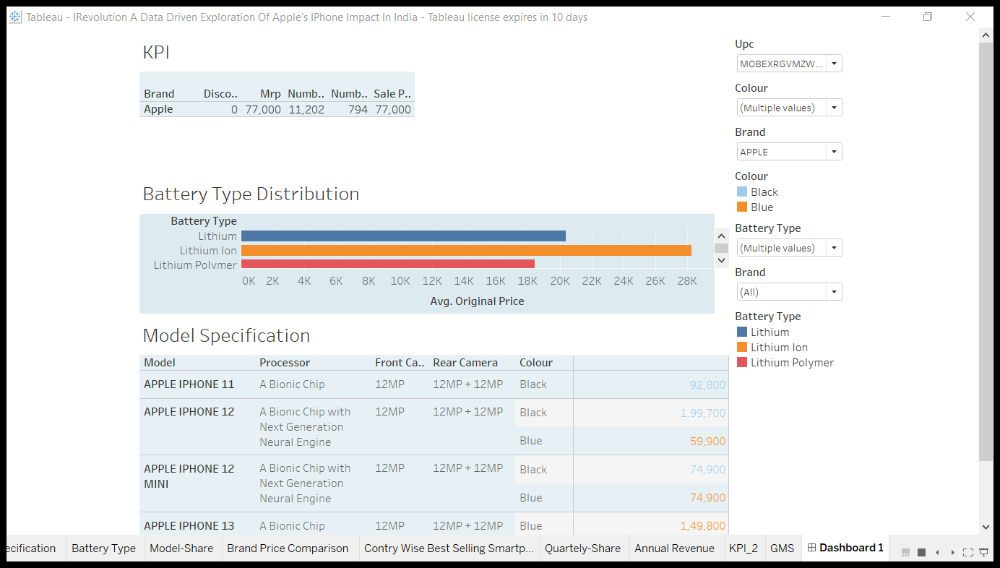

Slide 21
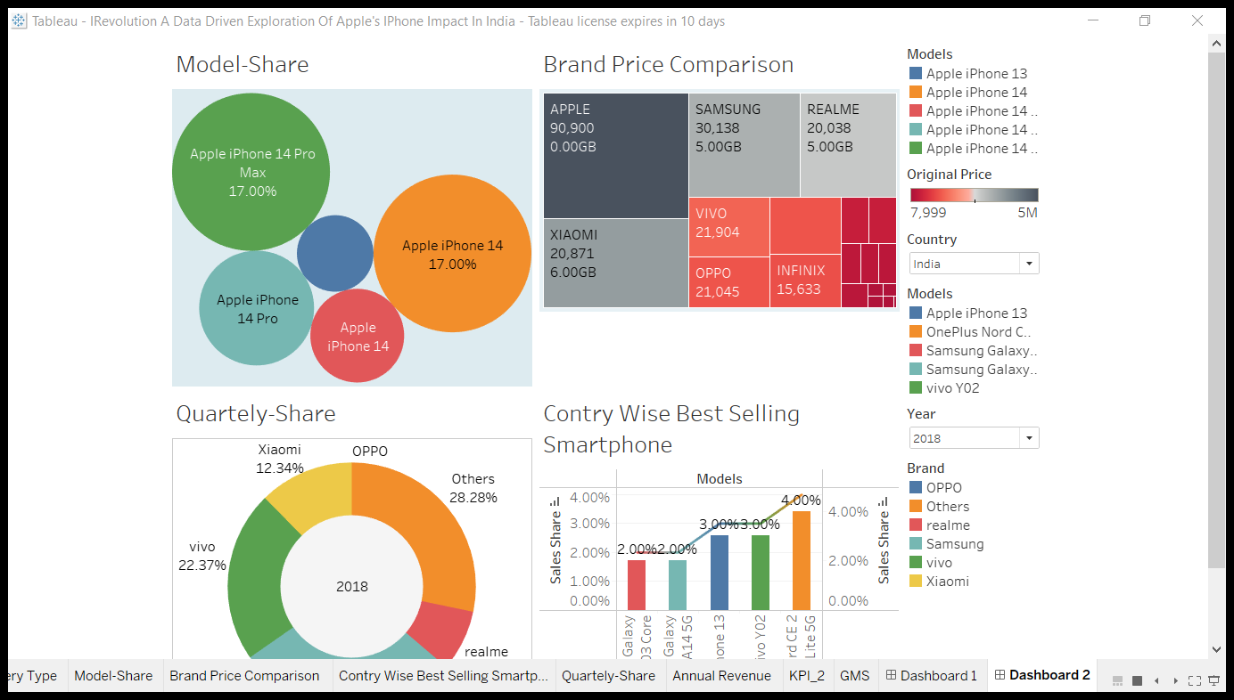

Slide 22
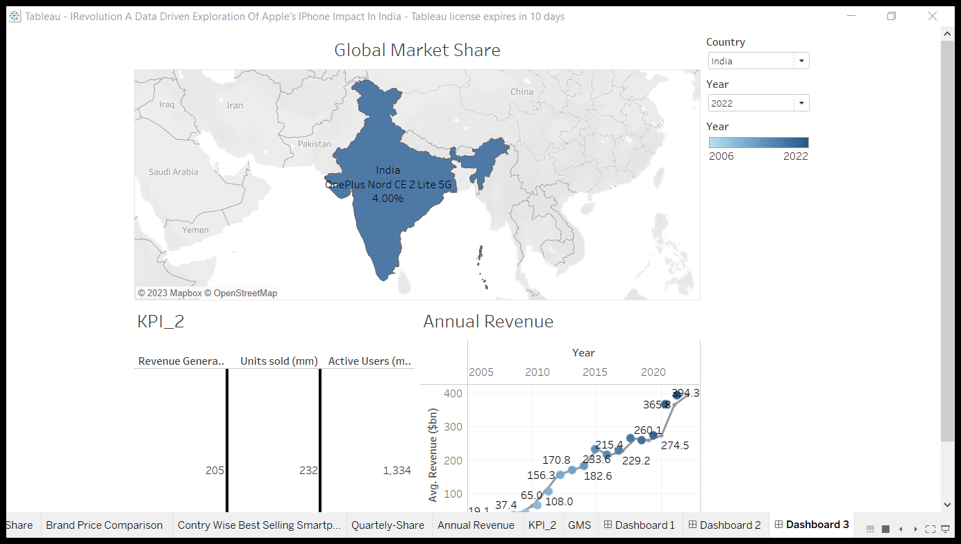

Slide 23

Story

Slide 24
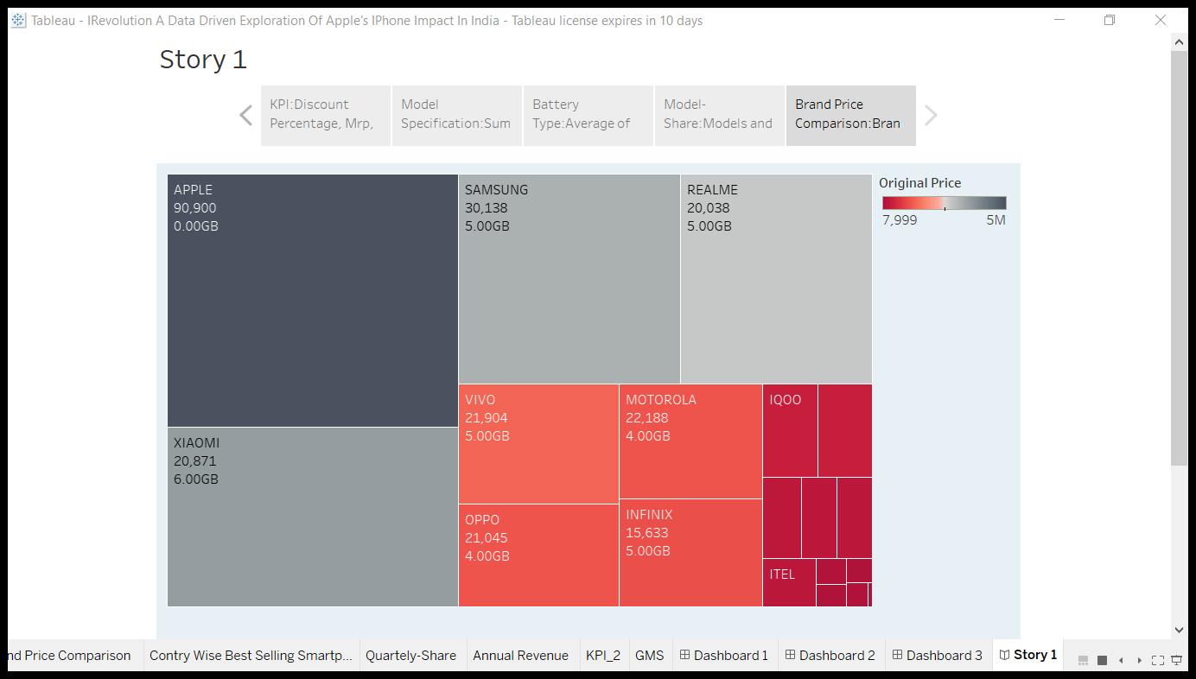

Slide 25
